Slide 1

LOUIS ISADORE KHAN

Slide 2
S. Sruthi (2013701032)
P. Ramya (2013701024)

Slide 3
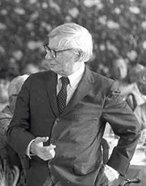

Slide 4
LIFE
Louis khan, whoseoriginal name was Ltze- Leib (Leiser- Ltze) Schmuilowsky (Schmalowski), was Born February 20,1901 into a poor jewish Family in Kuressaare on the Estonian of saaremmaa.
Khan’s Jewish parents immigrated to the united states in 1906.
The family couldn’t afford pencils but made their own charcoal sticks from burnt twigs so that Louis could earn a little money from drawing and later by playing piano to accompany silent movies.
He became naturalized citizen on may 15,1914. his farther changed their name in 1915.

Slide 5
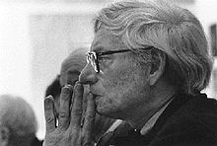
LIFE

Slide 6
Career
He was a world-renowned architecture orgin based in phliladelphia,united states.
Trained at the university of Pennsylvania
While continuing his private he served as critic and professor of architecture at Yale School Architecture from 1947to1957 From 1957 until his death he was a professor of architure at the School of Design University of Pennsylvania.
After completing his Bachelor of Architecture in 1924, Kahn worked as senior draft man in the office of City Architect John Molitor. In this capacity, he worked on the design for the 1926 sesquicentennial Exposition.

Slide 7
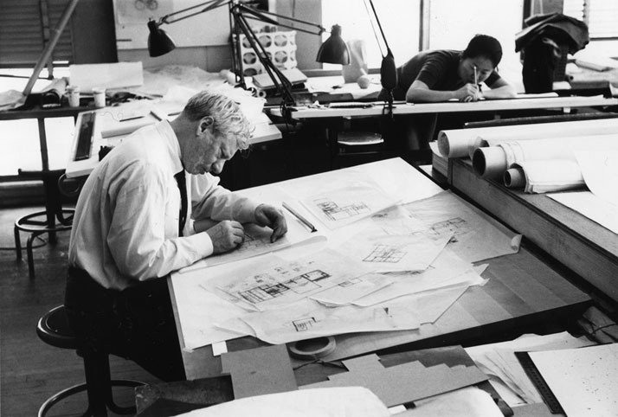
CAREER

Slide 8
EDUCATIONAL/OCCUPATION
He attended the university of Pennsylvania and received his bachelors degree in architecture at the of 24.
After college, he worked as a senior draftsman in the office of Philadelphia city architect john molitor .
To find his inspiration, he traveled through Europe visiting castles and medieval strongholds in 1928, only 4 years after graduating.
He finally started his own firm in 1935.
While he still designed and worked as a design critic on the side, louis became a professor of architecture at Yale School of Architecture.

Slide 9
HIS STYLE
Louis kahn’s worked infused the international style with a fastidious, highly personal taste ,a poetry of light.
He was known for his ability to create monumental architecture with creating strong formal distinctions between served spaces and servant spaces.
Isamu Noguchi called him “a philosopher among architects.
His palette of material tended toward heavily textured brick and bare concrete, the textures often reinforced by juxtaposition to highly refined surfaces such as travertine marble.

Slide 10
Kahn also worked closely with engineers and contractors on his buildings
There results were often technically innovative and highly refined.
In addition to the influence Kahn's more well-known work has on contemporary architects.
The architects of the cast concrete Louis Kahn used on many of his building were desired from his fascination with ancient stone architecture.

Slide 11
PERSONAL DESIGNS
Kahn created many unique an intricate buildings, but among his most memorable ware….
1.the Yale University Art Gallery:1951 2. The Jonas Salk institute for Biological
Studies:1965
3.The Margaret Esherick house:1961
4.The National Assembly buliding:1962

Slide 12
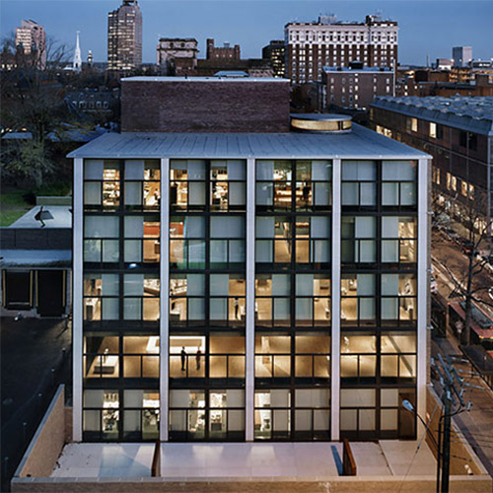
CREATIONS

Slide 13
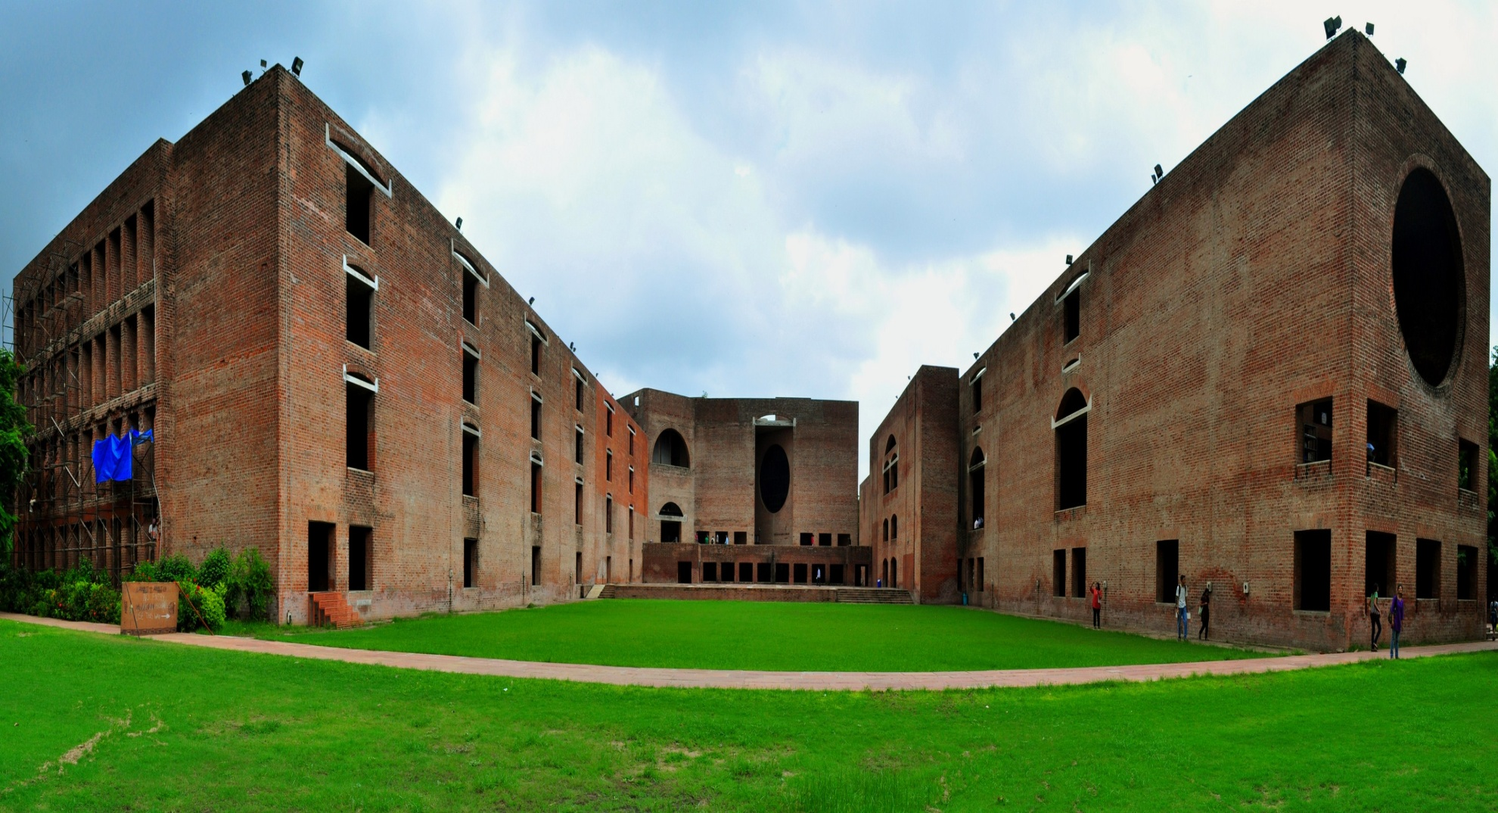
INDIAN-INSTITUTE –OF MANAGEMENT-AHMEDABAD

Slide 14
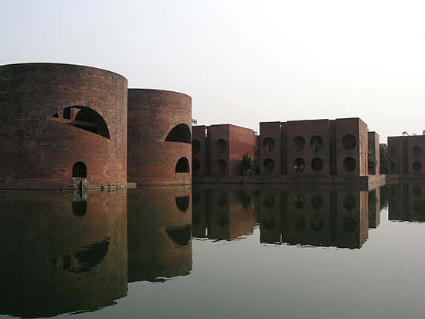
NATINAL ASSEMBLY BUILDING –DHAKA BANGLADESH

Slide 15
BULIDINGS
The Yale university art gallery
1. said to be kahn’s first significant commission.
2.Uses many bold lines, both parellel and perpendicular , to make a statement.
3.in this amazing creations, he uses hollow tetrahedral concrete ceiling and floor slab system, which accommodate the mechanical and electrical systems.

Slide 16
BULIDINGS
The Jonas Salk Institute for Biological Studies.
Made to be a “Garden” of stone and water.
Built from reinforced concrete, marble, crystal,wood,and water this masterpiece stands with two parallel laboratories each 65 feet wide, and 245 feet long.

Slide 17
BULIDINGS
The Margaret Esherick house
1.built 1961
2.One of Kahn’s few houses designs
3.built mainly of stucco and wood
4.It is a one bedroom residence created for a local bookstore owner Margaret Esherick during that time
5.Uses streamline silhouettes to open up space and use natural light in a new an inventive way.

Slide 18
YALE UNIVERSITY

Slide 19
GEOMETARY IN HIS WORK
Kahn used many different shapes and lines to crate his masterpieces. However, among his most famous creations, he seems to favor both parallel and perpendicular lines. Through his bold technique, he created streamline,radial,and futuristic looking buildings. His stile is his own, and his creations are legendary, through the use of geometry, he has created both beautiful works of art. And useful establishments, for the whole to enjoy.

Slide 20
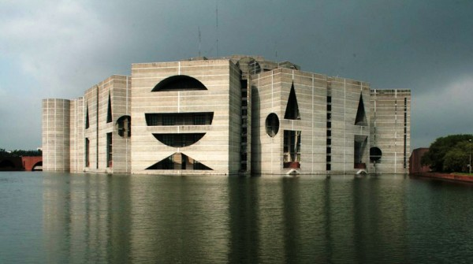
NATIONAL ASSEMBLY BULIDING -DHAKA

Slide 21
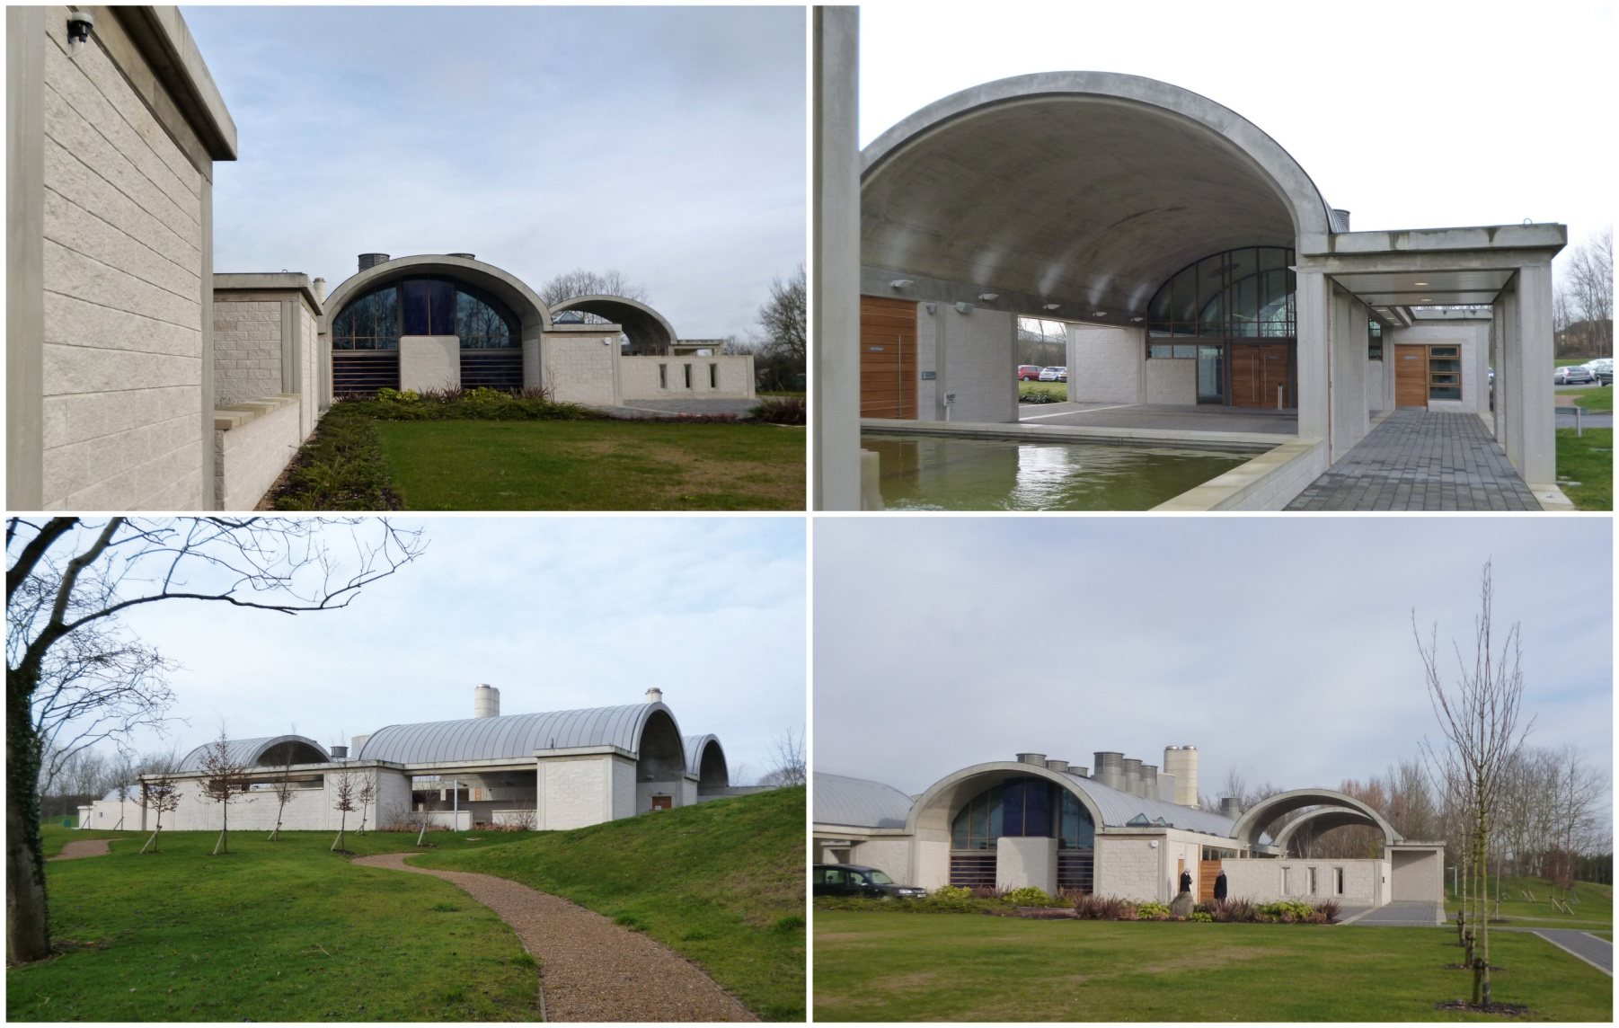

Slide 22
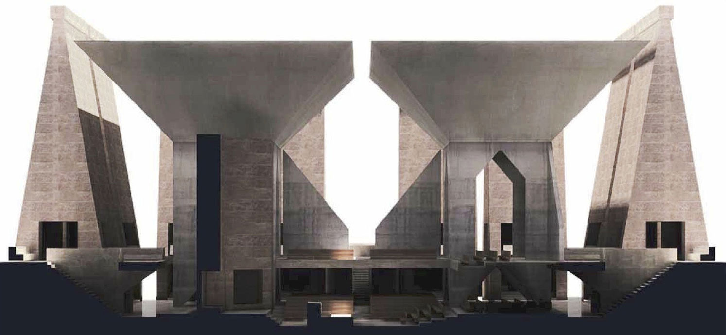
HURVA SECTION

Slide 23
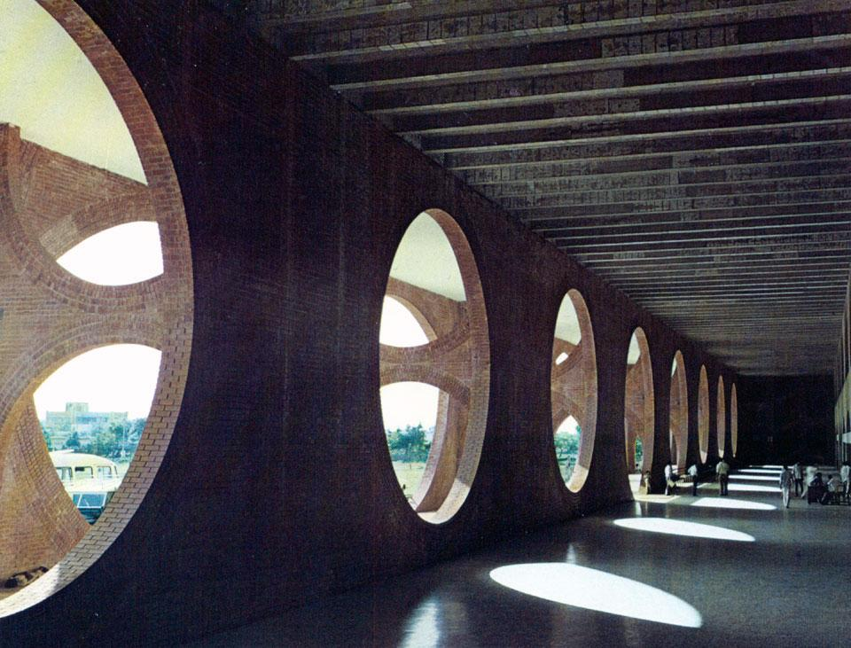
MATERIAL
While his favored simple material such as brick and concrete, he used in new ways.

Slide 24
PERSONAL LIFE
Mr. Kahn ‘s office was in Philadelphia, where he lived until his death. In 1930,he married Esther Israli,with whom he had a daughter, sue ann. Kahn also he had two other children by women with whom he had long-running extramarital affairs. Alexandra tyng, daughter of Anne tyng,another architect. And narthanielkahn,son of Harriet pattison,a landscape architect who worked in Kahn’s office.

Slide 25
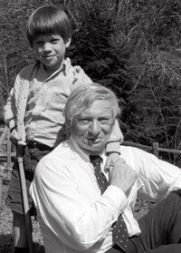
PERSONAL LIFE

Slide 26
MARGARRT HOUSE
My Father house Louis kahn’s Margaret House (1961)Although this house is not design for Kahn’s Family, Louis khan only three major Architectural homes in his career, and Esherick house was featured in Nathaniel Kahn’s My Architect documentary about his father and family. The Esherick House on Chestnut hill in Philadelphia is small, one- person, two storey box of stucco and stained timber that sits on six acres of established garden

Slide 27
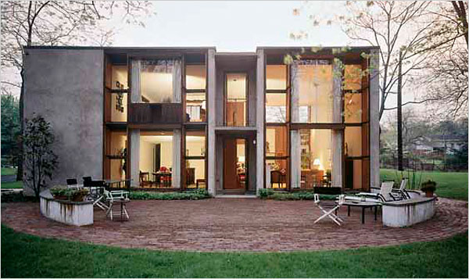
ESHERICK HOUSE

Slide 28
ESHERICK HOUSE
Louis kahns Esherick house by Ludvik kountary-Ronen Bekerman 3d architectural visualization building designed by Louis Kahn and completed in1961, Esherick House in located in the Northwest Philadelphia neighborhood of chestnut hill.

Slide 29
Born february 20,1901
Kuressaare,governoratr of livonia,Russsan
Empire.
Died march 17,1974(aged73)
New Yark city New Yark united states Nationality - American
Awards - AIA Gold medal
RIBA Gold medal

Slide 30
Buildings - Jatiyo Sangahad bhaban
Yale University Art Gallery
Salk Institute
Indian Institute of Management
Ahmadabad Philips Exeter academy Library
Kim bell Art Museum
Projects - Center of Philadelphia, Urban and Traffic Study

Slide 31
THANK YOU

